Slide 1


Service Providers Orientation
Sonoma County Human Services Department Adult & Aging/Area Agency on Aging

Slide 2

Welcome
&
Introductions
Notes:
Sara

Slide 3
Agenda
Program Overview
Adult & Aging and the Area Agency on Aging
Area Plan
Aging & Disability Commission
Data System
FY 25/26 Contracts
Fiscal Overview
Monitoring
Budget Management & Modifications
Invoicing
Closeouts
Next Meeting
Q&A
Notes:
Cody

Slide 4
Sonoma County Human Services Department
Angela Stuckmann
Department Director
Divisions of the Human Services Department (HSD):
Adult & Aging (A&A)
Economic Assistance (EA)
Employment & Training (E&T)
Family, Youth & Children’s Services (FYC)
Administrative Services
Notes:
Cody

Slide 5
HSD – Adult & Aging Division
Paul Dunaway
Division Director of Adult & Aging
Director of Area Agency on Aging
Direct Services:
Adult Protective Services
Long Term Services & Supports
Community Services
Veterans Service Office
Public Administrator, Public Guardian, Public Conservator
Community Services & Initiatives:
Area Agency On Aging
Aging & Disability Resource Hub
Local Master Plan On Aging
Local Aging And Disability Action Plan
Notes:
Cody

Slide 6
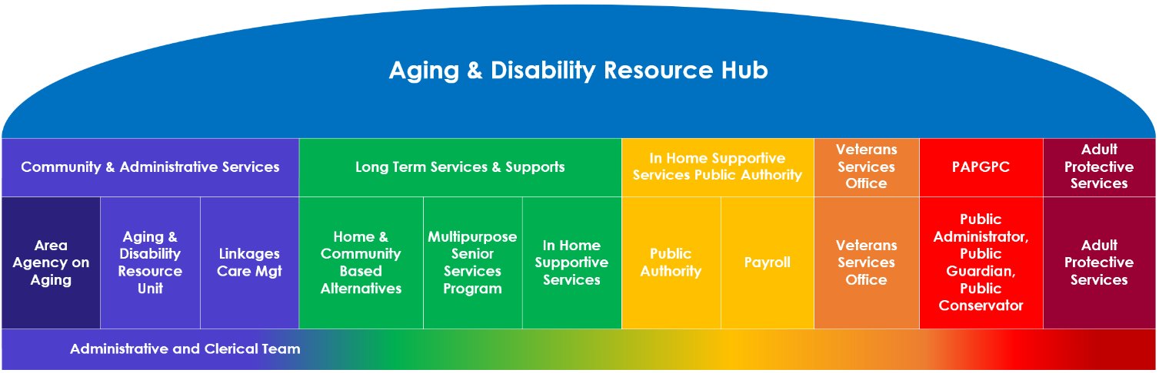
Sonoma County Human Services Adult & Aging Division
Notes:
Cody

Slide 7
Area Agency on Aging
Paul Dunaway
Division Director of Adult & Aging
Director of Area Agency on Aging
Sara Avery
Community & Admin Services Section Manager
Cody Milner
Community Services Program Manager
Joni Huntsperger
MPA and LADAP Program Manager
Kathleen Cortez
Program Planning and Evaluation Analyst
Annie Silverman
Program Planning and Evaluation Analyst
CB Wohl
Program Planning and Evaluation Analyst
Betsey Harper
Program Planning and Evaluation Analyst
Cassandra Denson
Administrative Aide
Kelly Dixon
CFHL Administrative Aide
Notes:
Cody

Slide 8
Meet your AAA Scope of Work Manager
Betsey Harper – ADRH and Case Management
West County Community Services
Linkages
Information & Assistance
Annie Silverman – Nutrition
Council on Aging
Petaluma People Services Center
Redwood Empire Food Bank
Eric Glentzer – Caregiver Supports
Alzheimer’s Association
NCO – Redwood Caregiver Resource Center
Petaluma People Services Center
Kathleen Cortez – Transportation, Disaster Prep, Legal Aid, & Ombudsman
Emergency Prep Help
Legal Aid of Sonoma County
Petaluma People Services Center
Senior Advocacy Services
Sebastopol Area Senior Center
CB Wohl – CalFresh Healthy Living, Alzheimer’s & Adult Day, MIPPA & HICAP
Center for Well Being
Council on Aging
Petaluma People Services Center
Sebastopol Area Senior Center
Senior Advocacy Services
Notes:
Cody

Slide 9
I have a question, who at AAA should I contact?
Contact your AAA Scope of Work Manager:
Program-specific questions
Regulations
Contracted Services
Contact the AAA Program Manager:
General Funding: Older Americans Act, Older Californians Act - Modernization
Aging & Disability Commission
Area Plan
AAA Network
Contact the Fiscal Team:
Invoicing Template
Fiscal Monitoring and Contract Resolution
Contact Cassandra Denson for Data related questions (including data entry, log in's, passwords, etc.)
Notes:
Cody

Slide 10
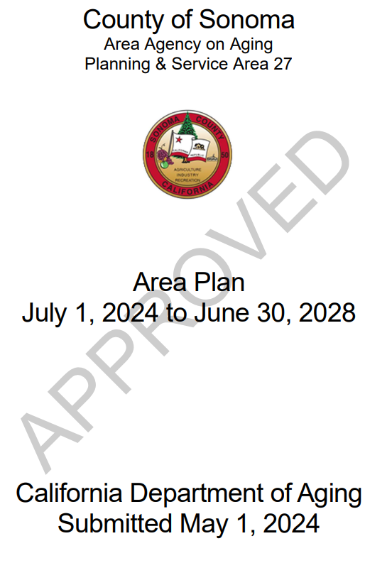
Sonoma County Area Plan 2024 – 2028
Needs Assessments:
Surveys: 1,679
Focus Groups: 14
Stakeholder Interviews: 43
Targeted Populations:
Low-income housing communities
Rural/Geographically isolated areas
Urban Areas
LGBTQIA+
Spanish-speaking communities
Alzheimer’s Disease & Caregivers
People with Disabilities & Caregivers
Notes:
Cody
To determine how we distribute Older American’s Act, Older Californian’s Act, and Transportation Grants, AAA completes a 4-year plan. The current plan runs from 2024 to 2028.
To develop the plan, AAA staff elecit input from key stakeholders. This was done through:
Surveys: 1,679
Online and Paper
English 1,565 Received
Spanish 114 Received
Focus Groups: 14
Targeted groups included low-income housing communities, Spanish-speakers, Rural/Geographically isolated areas, Urban Areas, LGBTQIA+, Alzheimer’s Disease & Caregivers, People with Disabilities & Caregivers.
Stakeholder Interviews: 43
Leaders from Community Services & Supports, Health, Transportation, Housing, Caregiving, Emergency Preparedness, Protection from Abuse, and Economic Security.

Slide 11
Six Area Plan Goals for 2024 - 2028
Housing Security for all Ages & Stages
Health Reimagined
Diversity, Equity, Inclusion and Belonging (DEIB)
Caregiving That Works
Affording Aging
Aging & Disability Commission: Education & Advocacy
Notes:
Cody
The Sonoma County Area Agency on Aging has aligned its goals with the California Master Plan for Aging as informed by the Area Agency on Aging Needs Assessment consisting of surveys and focus groups, the Local Master Plan for Aging initiative, and the Local Aging & Disability Action Plan initiative.

Slide 12
Populations of Greatest Social and Economic Need
Older adults 60+, adults with disabilities, and their caregivers
Greatest Economic Need: income level at or below the federal poverty level
Greatest Social Need: noneconomic factors that restrict an individuals' ability to perform daily tasks or ability to live independently:
Physical or mental disability
Geographic isolation
Language barriers
Cultural or social isolation caused by racial and ethnic status, limited English proficiency, sexual orientation, HIV status, gender identify or gender expression.
Notes:
Cody

Slide 13
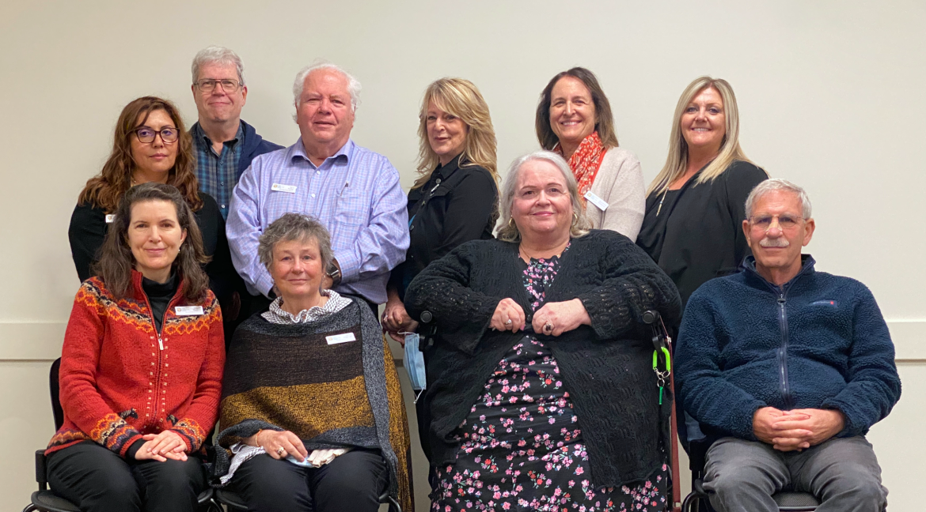

Purpose and Responsibilities of the Aging & Disability Commission
Federal and State Mandated
21 Member Advisory Board
Advise the Sonoma County Board of Supervisors
Advocacy
Community Representation
Public Engagement
Monitor
Education & Outreach
Sonoma County
Aging & Disability Commission
Notes:
Cody:
The Commission typically meets on the second Wednesday of the Month; no meetings in July and December. August is an all-day Planning Day.
The Executive Committee typically meets on the first Tuesday of the Month; no meetings in July and December
Agencies are HIGHLY encouraged to attend Commission Meetings (also written into your contract). Agencies are also encouraged to reach out to Cody if they have items or ideals that they would like to see at the Commission that would get them engaged and participating in the meetings.

Slide 14
Data System Update
Effective July 1, 2025, Sonoma County AAA has transitioned to a new Data Reporting Software.
New System: Shared Outcomes and Measurement System (SOMS)
SOMS is expected to go-live in the Fall 2025
What does this mean for Service Providers?
Provide using the Case Management Module will continue to use WellSky for client documentation.
Providers using WellSky for data entry or units of services, will temporarily hold data until SOMS is live.
Once SOMS is live, Service Providers will need to enter data from July to current.
Training will be provided
Notes:
Cody

Slide 15
Changes and Highlights of the FY 25/26 Contracts
New Exhibit A – Scope of Work(s)
Program Specific vs General Scope of Work Requirements
Program Specific Scope of Work:
Contract Overview
Time Frame
Funding Source
Geographic Service Area
Program Overview
CDA Service Category Definition
Program Specific Requirements
Location of Services
Units of Services
Reporting Units of Services
Data Collection
Ex A-Attachment:
Language Capacity
Equity Statement
Anti-Racist Results-Based Accountability (AR RBA) Plan
Voluntary Contributions/Program Income
Contract Funding
Service Compliance
Service Changes
Grievance Policy
Mandated Reporting
Service Provider Meeting Requirements
Security Awareness Training
Transition Plan
Notes:
Annie:
New Exhibit As
We have reorganized our Exhibit As so that the items in the right column are only listed once instead of accompanying each scope of work
Pause to let everyone read the slide
When we process our next round of amendments, we will make a few more changes to align language with CDA's 2025 Program Guide.
All changes will be made using track changes for your review and approval
Please review your scope of work. This is a formal agreement that lays out program requirements and deliverables
If you anticipate the need to deviate from your scope of work, reach out to your scope of work manager before any changes are made. Your scope of work manager will work with you to discuss any barriers and will work collaboratively towards a solution. Proactive communication is key here Communication is key, though.
Review the contract outcomes section of your scope of work
Let us know if you do not anticipate being able to meet these deliverables
We really appreciate early, proactive communication

Slide 16
Highlights for the FY 25/26 Contracts
Service Changes: “Contractor will ensure that proposed changes affecting the provision of services… must be communicated in writing via email to AAA Program Staff within ten (10) days of the proposed date of the change.
Security Awareness: Security Awareness Training is due by July 30th or within 30 days of the start of the contract. (That’s today)
Service Units – Reminder that Unduplicated counts start over starting July 1st.
Contractors should ensure they thoroughly read their contracts and understand the expectations outlined within them. CDA is cracking down on this and monitoring more closely.
Notes:
Annie:
Look at Kathleen's FAQs
New Exhibit As
Program vs General Exhibits
Expect more changes as we uniform and clean up the language so that Scopes of Works are clear, consistent, and concise.
Review the exhibit section that indicates the program requirements and their responsibility if they need to deviate from the scope of work.
Review contract outcomes data
Make sure your agency is aware of the outcomes/data elements, i.e. client counts and units of service.

Slide 17
Program Monitoring & Support
Contract Development & Expectations
Reporting
Technical Assistance & Training
Contract Monitoring
Corrective Action & Compliance
Evaluation & Feedback
Notes:
Annie
Our overarching goal through monitoring is to uplift successes, learn about barriers, and confirm that program delivery aligns with federal, state, and local regulations while also meeting service unit deliverables. We are monitored by the California Department of Aging every four years, and one of the areas they evaluate us is how we monitor our service providers.
We conduct program monitoring through ongoing touchstones such as:
Monthly invoice review
Data review
Regular communication
And annual or bi-annual (every-other-year) contract monitoring site visits which provide an opportunity to listen, learn, and align on program delivery.
Program monitoring also allows our team to identify areas where further technical assistance may be needed. We want to proactively identify areas for growth and provide you and your team with the information you need to implement program changes.
We may issue a Corrective Action Plan or CAP if we do not receive the required follow-up identified in the monitoring report by the specified date, or if the required follow-up does not align with federal, state, or local guidelines. We know that a CAP sounds scary and we assure you that it is our goal to work together to identify and implement needed changes.
We are deeply grateful to the work that each of you do every day for the communities you serve, and we want to provide you with the level of support and technical assistance you need for programs to thrive.

Slide 18
Meet your AAA Fiscal & Contract Team
Sarahi Mercado –Monitoring Accountant
Smercado@sonomacounty-hsd.gov
Megan Mitchell – Fiscal/Budget Accountant
Memitchell@sonomacounty-hsd.gov
Maria Soto Mendoza – Fiscal/Budget/Invoicing Accounting Technician
Msotomendoza@sonomacounty-hsd.gov
Amanda Gayda – Contracts
Contracts@sonomacounty-hsd.gov
Notes:
Megan

Slide 19
Fiscal Overview
Fiscal Monitoring
Contract Resolution
Budget Management
Budget Modifications
Invoicing
Closeouts
Notes:
Megan/Maria

Slide 20
Fiscal Monitoring
Fiscal Monitoring is completed during the contract term for all AAA service providers who receive Older Americans Act (OAA) funding.
The purpose of the Fiscal Monitoring is to examine a fraction of the current year’s expenditures and make any corrections needed during the fiscal year.
Notes:
Megan/Maria

Slide 21
Contract Resolution
Contract Resolution is completed once the contract term has ended.
The purpose of the Contract Resolution is to examine the prior fiscal year’s expenditures in order to deem the contract “resolved”.
Notes:
Megan/Maria

Slide 22
Budget Management
Fiscal and Program reviews and approves budget, budget modifications, and invoices
Common FAQ’s
Budget must match invoice template
Individual line items must not exceed budgeted amounts.
Budget modifications need to be submitted as soon as a revision is needed. Please send to Fiscal and Program for review and approval.
Invoices templates need to be revised to match the approved budget modification.
Contract amendment budgets need to match the invoice templates. Please update when receiving revised funding.

Slide 23
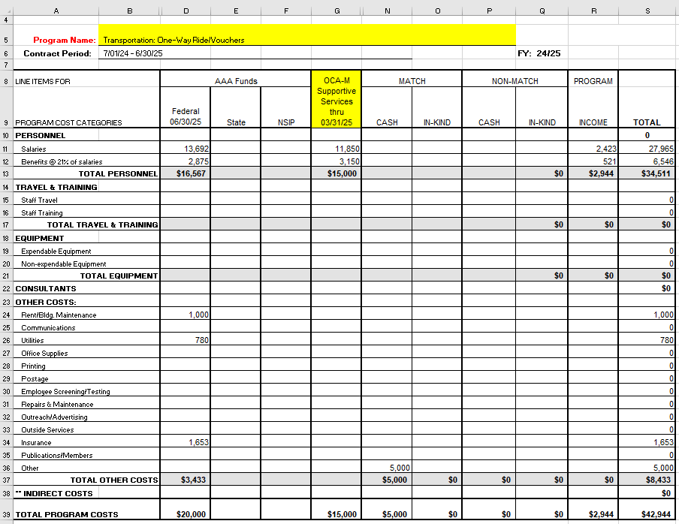
Invoicing
Summary Budget Allocation
Example: budget allocation as shown in contract
New due date for claim submission: 10th of each month (with exception of year-end)

Slide 24
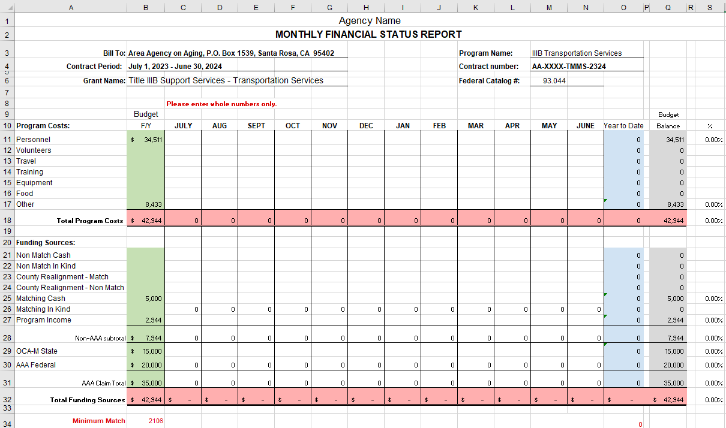
Invoicing
Financial Status Report
Total program costs should match total funding sources
Notes:
Megan/Maria

Slide 25
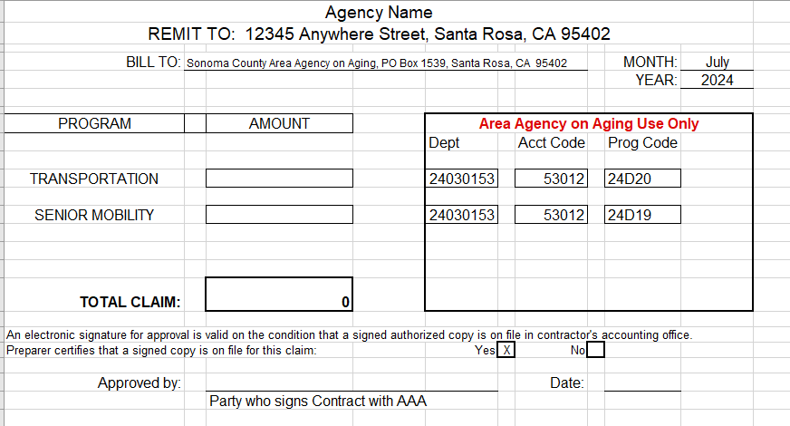
Invoicing
Claim Form
Amount should match billing on Financial Status Report
Matching row 31 on Financial Status Report

Slide 26
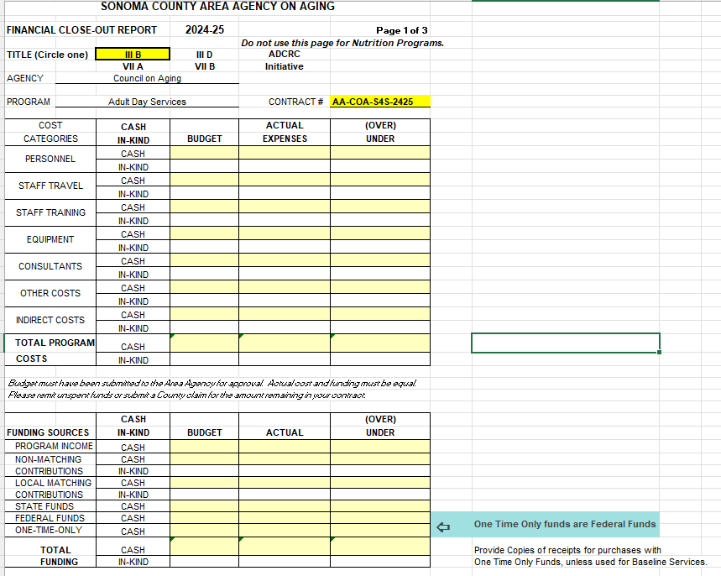
Year-end Closeout Due June 15th

Slide 27
Next Meeting
How often would Service Providers like to meet with AAA to discuss high-level contracting and OAA requirements?
Discuss contracts
Funding
Invoicing
Area Plan and Needs Assessments
How often would Service Providers like to meet with AAA to discuss program-specific TA?
Contract outcomes
Invoicing Processing
Program Monitoring
Notes:
CB
Regular Service Provider Meetings:
AAA to hold either Annual, biennial, or quarterly Service Provider Meetings. Do Service Providers have a preference or interest?
Regular AAA Staff Meetings:
AAA Staff is considering holding regular “office hours” for providers to attend and ask questions. Would your staff find value in having dedicated “office hours” with the PPEAs? (registered vs non-registered and Q&A sessions)

Slide 28

AAA Contacts:
Cody Milner
CMilner@schsd.org
Annie Silverman
ASilverman@schsd.org
Betsey Harper
BaHarper@schsd.org
Cassandra Denson
CDenson@schsd.org
CB Wohl
CWohl@schsd.org
Kathleen Cortez
KCortez@schsd.org
Fiscal Contacts:
Maria Soto Mendoza
MSotomendoza@sonomacounty-hsd.gov
Megan Mitchell
MeMitchell@sonomacounty-hsd.gov
Sarahi Diaz Acosta
SMercado@sonomacounty-hsd.gov
Contract Contact:
Amanda Gayda
Contracts@sonomacounty-hsd.gov
*HSD is moving to sonomacounty-hsd.gov
Notes:
Cody – note that the department is moving to a new email domain of "sonomacounty-hsd.gov

Slide 29

Q&A
This Photo by Unknown Author is licensed under CC BY-ND
Notes:
Question
Should AAAs spend State funds first, then the Federal funds?
Answer
In an effort to maintain consistent service levels, it is CDA’s expectation that each AAA spends all funds (State and Federal) available as allocated to each State Fiscal Year (SFY) and proportionately based on match requirements for the services provided.
However, for the HICAP grant only, since the HICAP Federal Grant does not require a State match and since it is now awarded for a three year period ending March 31, 2020, it allows the AAAs some flexibility in managing the funds. State funds are only available within the SFY and expenditures must be recorded by June 30 for each year’s appropriation. Unspent Federal funds may be carried over into the following SFY. Therefore, CDA is not instructing AAAs to spend State funds first, but rather to ensure that all State funds are expended prior to June 30 to maximize service levels. AAAs should be mindful that carryover of Federal funds from year-to-year should be minimal and not routine given service levels should be maintained as outlined in the initial allocation. Also, Federal funding from year-to-year is never a guarantee since the allocation provided in the budget display is what is anticipated at the point-in-time and could change due to subsequent enacted budgets

