Slide 1

CalMHSA CalAIM a
End User Training

Slide 2
Contents
CalAIM Training Courses
Logging into CalMHSA Moodle and Registering for Courses

Slide 3
CalMHSA CalAIM Training Courses MH and SUD
Course | Mental Health | SUD
01 – Foundation of Documentation and Service Delivery | ☑ | ☑
02 – Access to Services | ☑ | ☑
03 – Assessments | ☑ | ☑
04 – Diagnosis, Problem Lists, and Care Planning | ☑ | ☑
05 – Progress Notes | ☑ | ☑
06 – Care Coordination | ☑ | ☑
07 – Screening Tools for SMHS | ☑ | ☒
08 – Transition of Care Tool | ☑ | ☑
09 – Discharge Planning | ☑ | ☑
10 – Effective Administration of Screening Tools | ☑ | ☑
Coding for SMHS | ☑ | ☒
Coding for DMC and DMC-ODS | ☑ * | ☑
* If you provide both MH and SUD DMC/DMC-ODS Services

Slide 4
Logging into CalMHSA Moodle
Moodle courses: https://moodle.calmhsalearns.org/
When you go to the CalMHSA Moodle page, your dashboard will be blank, even if you have previously completed courses.
Select “Courses” at the top left of your screen and then select “All Courses”
For EHR training, select EHR
For CalAIM training, select Clinical Practice, then Non-CE Courses
Select the applicable courses to enroll in, and then select “Enroll me”. Repeat for each course that you are required to complete

Slide 5
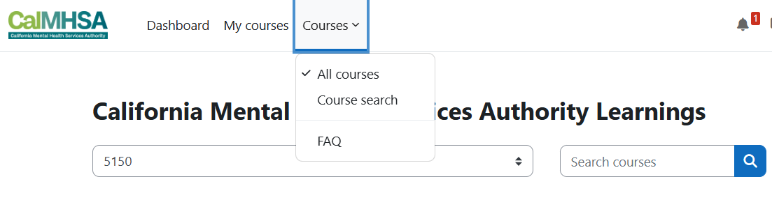

Slide 6
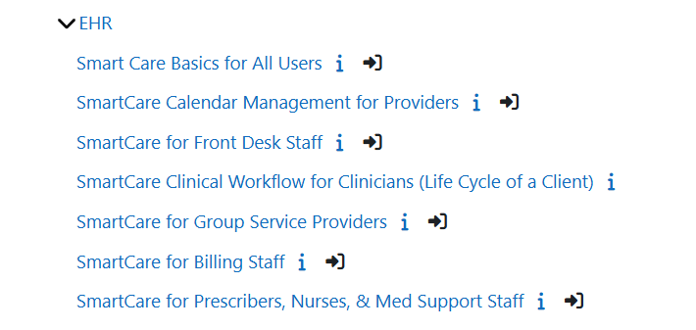
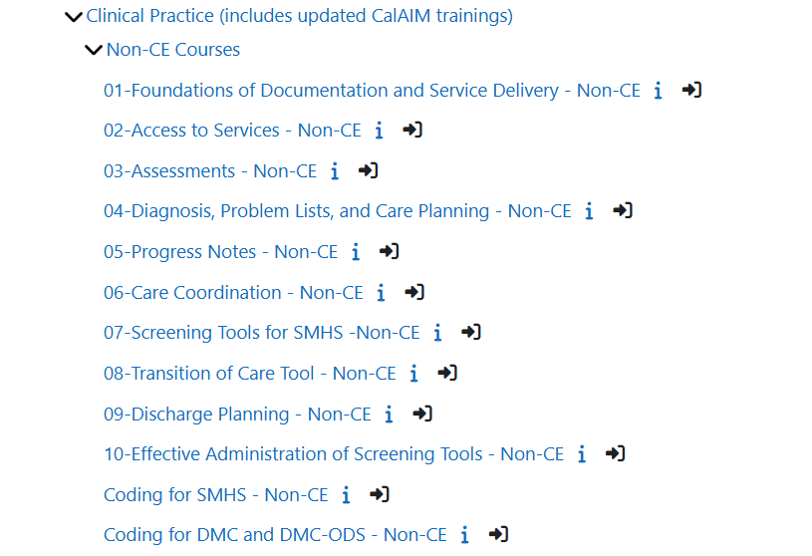
EHR Training
CalAIM Training

Slide 7
