Slide 1

Member Grievances Training
Sonoma County Behavioral Health
Quality Assurance
Mental Health Plan / Drug Medi-Cal Plan
From here-out to be referred to as Plans

Slide 2
Training Goals & Objectives
Goals:
  Establish or refresh your understanding of the requirements and processes associated with handling Medi-Cal member grievances
Objectives:
  Create universal understanding of grievances, related processes, resolution deadlines, and reporting requirements.

Slide 3
What is a Grievance?
An expression of dissatisfaction to DHS-BHD about any matter other than an Adverse Benefit Determination.
Grievances may include, but are not limited to, the quality of care or services provided, and aspects of interpersonal relationships such as rudeness of a provider or employee, or failure to respect the beneficiary's rights regardless of whether remedial action is requested
Note: A complaint is the same as a grievance. A member need not use the term “grievance” for a complaint to be captured as an expression of dissatisfaction and, therefore, is a grievance.

Slide 4
Grievance Categories
There are six core grievance categories:
Access – Service availability/access
Quality of Care – Staff behavior/treatment concerns
Change of Provider – Complaint related to a COP request
Confidentiality – Unauthorized/improper release of information
Other – Financial, lost property, patients' rights, etc.
Discrimination – Complaint concerning the unlawful discrimination of any characteristic protected under the federal or state law (sex, race, color, religion, ancestry, national origin, etc.)

Slide 5
Transgender, Gender Diverse, or Intersex Cultural Competency Training Requirements
DHCS has a new requirement that county providers and Medi-Cal contracted providers must complete a training related to Trans –inclusive care. All new employees must complete this training within 45 days of hire
Tran-inclusive grievances resolved in the member’s favors will require the identified provider to retake the applicable trans-inclusive refresher course withing 45 day so the resolution and prior to rendering services.
For specific information on accessing the training, please contact your immediate supervisor.

Slide 6
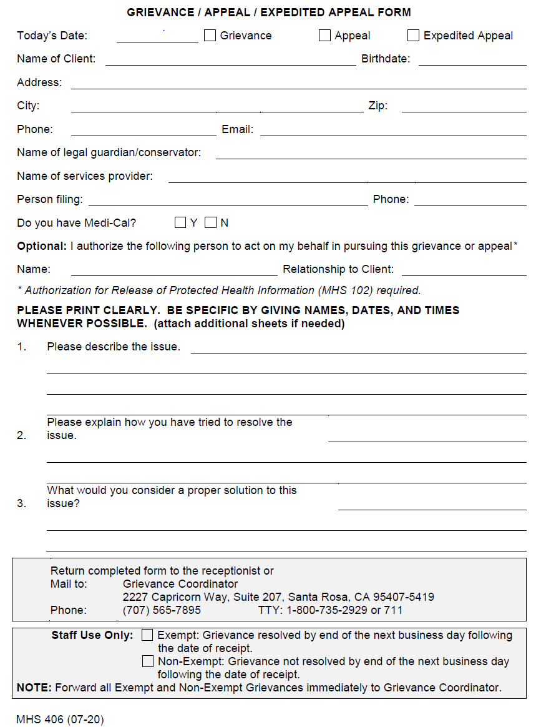
Grievance Form

Slide 7
Grievance Process

Slide 8
Grievance Process
Grievances can be filed by the member one of two ways:
  Directly with the county's behavior health department
  Directly with the member’s provider.
There are three types of grievance processes:
  Exempt – When a grievance is resolved (to the beneficiary’s satisfaction) within the first business day, the grievance will be exempt from needing a full investigation, acknowledgement and resolution letter.
  Non-Exempt – A grievance not resolved within the first business day. Requires full investigation, acknowledgement and resolution letter.
  Referred – Grievance that is either not associated with a complaint about the contracted provider or the BHD, or a grievance that is not within the provider’s jurisdiction to resolve (Ex: a beneficiary has a grievance related to the Sheriff's Dept.)
    These grievances involve the filer being referred to the appropriate agency or department.

Slide 9
Grievances Filed with BHD Process
1) Grievances can be filled by the member in the following ways:
  Verbally (Over the phone or In person)
  In writing (Email or mail)
2) Clinical Specialist logs the grievance & contacts the provider (via email) to notify that a grievance has been filed.
  Grievance Coordinator/Clinical Specialist mails the beneficiary a formal acknowledgement letter, stating that the grievance is being investigated.
3) The provider & section manager work with the member to resolve the grievance
  The grievance must be resolved within 30 Calendar days of the filing date.
  Grievance Coordinator/Clinical Specialist will review all evidence, and action items take to determine resolution of grievance.
4) Once the resolution is resolved a formal resolution letter will be mailed
  The letter reviews the nature of the grievance, steps taken to resolve, and the final determination.

Slide 10
Grievances Filed with the Provider
Member brings concern to the provider
Provider responds by offering the Grievance Form
Offer to assist in the completion of the form
Offer to resolve the grievance
Completed form sent securely to Grievance Coordinator/Clinical Specialists
2) If Grievance is not resolved within one business day of filing – Non-Exempt
Grievance Coordinator/Clinical specialists sends formal grievance acknowledgement letter to beneficiary
Formal grievance investigation begins (evidence collected, action items reviewed, etc)
Grievance Coordinator/Clinical Specialists coordinates with CBO to ensure timely resolution of grievance (within 30 days of filing)
4) At the conclusion of the investigation Grievance Coordinator will send resolution letter to provider and member.
No Resolution Letter if grievance is exempt

Slide 11
FORM COMPLETION - EXEMPT
Mark the “grievance” box at the top of the form.
In Section 3 indicate what action was taken by the provider to resolve the grievance.
In the Staff Use Only Section Check the “Exempt” box
Note the date the grievance was resolved
Send the completed form to the DHS- BHD Grievance Coordinator immediately

Slide 12
FORM COMPLETION – NON-EXEMPT
Mark the “grievance” box at the top of the form.
In Section 3 indicate what action was taken by the provider to resolve the grievance.
In the Staff Use Only Section Check the “Non-Exempt” box
Send the completed form to the DHS- BHD Grievance Coordinator immediately

Slide 13
FORM COMPLETION – REFERRED
Inform filer of referred status
Mark the “grievance” box at the top of the form.
In the Staff Use Only Section a. Check the “Exempt” box and write “referred”
Note the date the grievance was referred and to whom.
Send the completed form to the DHS- BHD Grievance Coordinator immediately

Slide 14
Grievance Tracking & Reporting

Slide 15
Grievance Tracking & Reporting
To ensure accurate tracking and reporting, providers are required to do the following:
  Develop and establish a tracking method to log grievances
  Retain copies of all filled grievances and immediately submit grievance to the BHD via secure email BHQA@sonoma-county.org
  Complete and submit quarterly grievance report to BHD via secure email BHQA@sonoma-county.org

Slide 16
Grievance Tracking & Reporting
Contracted Provider Name:
GRIEVANCES
CATEGORY | REPORTING PERIOD |  |  |  | DISPOSTION
ACCESS | Quarter 1 | Quarter 2 | Quarter 3 | Quarter 4 | Resolved Quarter 1 | Referred Out Quarter 1 | Pending Close of Quarter 1
Service Not Available
Service Not Accessible
Timeliness of Services
24/7 Toll-free Access Line
Linguistic Services
Other Access Issues
TOTAL | 0 | 0 | 0 | 0 | 0 | 0 | 0
QUALITY OF CARE | Quarter 1 | Quarter 2 | Quarter 3 | Quarter 4 | Resolved Quarter 1 | Referred Out Quarter 1 | Pending Close of Quarter 1
Staff Behavior Concerns
Treatment Issues or Concerns
Medication Concerns
Cultural Appropriateness
Other Quality of Care Issues
TOTAL | 0 | 0 | 0 | 0 | 0 | 0 | 0
CHANGE OF PROVIDER | Quarter 1 | Quarter 2 | Quarter 3 | Quarter 4 | Resolved Quarter 1 | Referred Out Quarter 1 | Pending Close of Quarter 1
TOTAL | 0 | 0 | 0 | 0 | 0 | 0 | 0
 | Quarter 1 | Quarter 2 | Quarter 3 | Quarter 4 | Resolved Quarter 1 | Referred Out Quarter 1 | Pending Close of Quarter 1
CONFIDENTIALITY CONCERN
TOTAL | 0 | 0 | 0 | 0 | 0 | 0 | 0
OTHER | Quarter 1 | Quarter 2 | Quarter 3 | Quarter 4 | Resolved Quarter 1 | Referred Out Quarter 1 | Pending Close of Quarter 1
Financial
Lost Property
Operational
Patients' Rights
Peer behaviors
Physical environment
Other grievance not listed above
TOTAL | 0 | 0 | 0 | 0 | 0 | 0 | 0
GRAND TOTAL | 0 | 0 | 0 | 0 | 0 | 0 | 0
Quarterly report for CBO’s
Tracker is emailed quarterly by grievance coordinators

Slide 17
Grievance Tracking & Reporting
Quarterly Reporting Schedule
Quarter Period |  | Report Due to SCBH
Quarter 1: | July 1- September 30 | October 1
Quarter 2: | October 1- December 31 | January 1
Quarter 3: | January 1- March 31 | April 1
Quarter 4: | April 1- June 30 | July 1
Submit Completed Report and All Supporting Documents (via secure e-mail) to: bhqa@sonoma-county.org

Slide 18
Resources

Slide 19
Resources
Members should be informed of the grievance process in the following ways:
The Behavioral Health Member Handbook
Beneficiary (Member) Rights Flyer
Beneficiary (Member) Rights and Grievance/Appeal Process and Form
Note: Above mentioned resources are among the required Medi-Cal informing materials and should be posted and available to all members.

Slide 20
Resources
Grievance Form
  BHD 406 Member Grievance Appeal Process and Form
Form and Reporting Submittal
  BHQA@sonomacounty.gov
Grievance Questions or Support:
Jeremiah Watts
QA Manager
Email: Jeremiah.Watts@sonomacounty.gov
Phone: 707-291-0319
Trisha Sheldon
Grievance Coordinator/QA Specialist
E-mail: Trisha.Sheldon@sonomacounty.gov
Phone: 707-565-5129

