Slide 1

Employee Benefits

Slide 2
What will we cover today?
Eligibility
Waiver and Declination
Change of Status/Mid-Year Enrollment Changes
Medical/Dental and Vision
Additional Benefits
Flexible Spending Accounts (FSA)
Retiree Medical Benefits
Life Insurance
Staff Development Allowance
Regional Parks Pass
Clean Commute
EAP, Health Care Advocacy
Intranet/Internet resources
Notes:
Hello everyone, I’m Jeremy Hill and I’m an analyst in the Benefits Unit.
We’re going to cover quite a bit of information today but please don’t think you need to memorize everything.
The purpose of this presentation is to go through each of the many benefits we offer, give you a general overview of each with some examples, point you to resources that we offer if you have issues or questions, and generally make you aware of your responsibilities and deadlines.
Feel free to ask questions as we go and there will be a break in the middle.

Slide 3


Full Time Employees
Must be eligible for benefits per your Memorandum of Understanding (MOU) or Salary Resolution
How much are the premiums?
Salary Resolution, SCDPDAA, SCLEMA, SCPDIA, and SCPA bargaining units will receive full County contribution if FTE is at least .75 (60 hours or more bi-weekly)
All other Bargaining Units will receive the full County contribution with a 1 FTE.
Notes:
No one can be covered on two separate county plans. So if your parent is a county employee and you’re currently covered on your parent’s plan, you can either stay on their plan or add your own, you cannot do both. If you and your spouse are both county employees, any of your dependents can only be on one of your plans. Although one person can cover them on dental and the other person can cover them on vision, as an example. You cannot both cover them on medical, dental, or vision.

Slide 4




Part Time Employees
To first qualify for health benefits, you must be in an allocated position of .4 FTE (32 hours or more bi-weekly).
Salary Resolution, SCDPDAA, SCLEMA, SCPDIA, and SCPA bargaining units will receive full county contribution if FTE is at least .75 (60 hours or more bi-weekly)
How much are the premiums?
County’s contribution toward premiums is prorated based on the number of hours work.
Based on the number of qualifying hours compared to a full-time employee.
Qualifying hours include hours worked and qualified leave hours.
Contact your Payroll Clerk if you have questions regarding your eligibility for a prorated County Contribution.
Notes:
No one can be covered on two separate county plans. So if your parent is a county employee and you’re currently covered on your parent’s plan, you can either stay on their plan or add your own, you cannot do both. If you and your spouse are both county employees, any of your dependents can only be on one of your plans. Although one person can cover them on dental and the other person can cover them on vision, as an example. You cannot both cover them on medical, dental, or vision.

Slide 5


Extra Help Benefits
To first qualify for health benefits, you must work at least 80 hours over two consecutive pay periods.
Information and details for enrollment will be mailed to your home address and emailed to your County email address once you become eligible!
How much are the premiums?
County’s contribution is based on the hours worked in a pay period. You must work a minimum of 20 hours in the pay period.
Premiums are paid in advance on the first two pay dates of the month prior to the coverage effective date.
What are you eligible for?
Medical
(no dental or vision)
Employee Assistance Program (EAP)
Some other programs, based on Bargaining Unit (covered later!)
Notes:
No one can be covered on two separate county plans. So if your parent is a county employee and you’re currently covered on your parent’s plan, you can either stay on their plan or add your own, you cannot do both. If you and your spouse are both county employees, any of your dependents can only be on one of your plans. Although one person can cover them on dental and the other person can cover them on vision, as an example. You cannot both cover them on medical, dental, or vision.

Slide 6
Dependent Eligibility
If you are eligible to participate in a County-sponsored medical, dental or vision plan, your eligible dependents may also participate.
They include:
Your lawfully married spouse or domestic partner (registered or County affidavit)
Your spouse/domestic partner’s dependents including child, step-child, adopted child, eligible foster child or child for whom you are legally appointed guardian
Any age if permanently and totally disabled and enrolled in the plan prior to attaining limiting age
Notes:
If you are eligible to participate in a County-Sponsored medical, dental or vision plan, then your eligible dependents may also participate. These can include:
Your lawfully married spouse or domestic partner (either registered with the state or attested via County affidavit, depending on bargaining unit)
Your spouse/domestic partner’s dependents including child, step-child, adopted child, eligible foster child or child for whom you are legally appointed guardian
Dependents of any age if permanently and totally disabled and enrolled in the plan prior to attaining limiting age. For dependents with a disability, there is an annual process to re-certify through the insurance carrier.

Slide 7
Evidence of Eligibility Required
Dependent | Age | Eligibility Definition | Documents Required
Spouse | N/A | Person to whom you are legally married | Marriage Certificate
Domestic Partners | At least 18 | Meet County Domestic Partner Eligibility Requirements | SEIU: County Affidavit or Declaration of Domestic Partnership filed with the California Secretary of State ALL OTHERS/SAL RES: Declaration of Domestic Partnership filed with the California Secretary of State
Child(ren) | Under Age 26 | Minor or Adult Child(ren) of Employee who is under the age of 26yrs regardless of marital status | Birth Certificate
Stepchild(ren) | Under Age 26 | Minor or Adult Child(ren) of Employee Spouse who is under the age of 26yrs regardless of marital status | Marriage Certificate -and- Birth Certificate showing Spouse as Parent
Children Legally Adopted/Wards | Under Age 26 | Minor or Adult Child(ren) legally adopted by Employee under the age of 26 yrs regardless of marital status | Court documentation (Must include presiding Judge Signature & Court Seal)
Children of Domestic Partners | Under Age 26 | Minor or Adult Child(ren) of Employee Domestic Partner who is under the age of 26yrs | SEIU: County Affidavit or Declaration of Partnership filed with the California Secretary of State -and-Birth Certificate showing Domestic Partner as Parent ALL OTHERS/SAL RES: Declaration of Domestic Partnership filed with the California Secretary of State-and-Birth Certificate showing parent as Domestic Partner
Notes:
This slide has examples of the types of documentation required for each dependent, as well as a breakdown by bargaining unit for some of the differences regarding domestic partners. (note that your bargaining unit is salient for several aspects of benefits) [[read through examples on the slide]]
Again, all of this information is in the Employee Benefits Guide, which can be found on our website in PDF form.

Slide 8


Dual Coverage
An eligible employee may be enrolled in a County sponsored health plan* as the primary subscriber or on another county employee or retiree’s plan as a dependent, but not both.
Eligible dependents cannot be covered by more than one County sponsored health plan.
*Health plan is Medical, Dental, Vision, Life insurance and post-employment contributions to a Retiree Health Reimbursement Arrangement (HRA) or a Retiree Medical Trust (RMT)
Notes:
No one can be covered on two separate county plans. So if your parent is a county employee and you’re currently covered on your parent’s plan, you can either stay on their plan or add your own, you cannot do both. If you and your spouse are both county employees, any of your dependents can only be on one of your plans. Although one person can cover them on dental and the other person can cover them on vision, as an example. You cannot both cover them on medical, dental, or vision.

Slide 9
Waiver and Declination
Enrollment in the County Medical and Dental plans are voluntary…
You may waive coverage if…
You have other group medical coverage
Changes can be made mid-year for qualified life events with proof
You can decline coverage if…
Default, if no election is made
You have no other group medical coverage
Enrollment allowed during Annual Enrollment only
Notes:
So our enrollment form gives you the option to either waive or decline coverage, if you are not electing now. The difference is pretty important – (read from slide).
Its important to know that declining is the DEFAULT if we do not receive your form. So if you have other coverage through a spouse and you choose not to turn our form in now, but then you lose that other coverage, you will not be able to add the county benefit until annual enrollment, unless you have a waiver on file. So get the form in, check the Waive box and sign the waiver if you do not need coverage now, and you keep all your options open down the road.

Slide 10

Mid-Year Changes and Annual Enrollment
Forms must be submitted to our Unit within 31 days of a qualifying work or life event, which can include:
Marriage or divorce
Gaining or losing a dependent
Gaining or losing other group coverage
Change in your employment status, including a leave of absence (or return to work from leave)
The Annual Enrollment Period is in March of each year!
Opportunity to add, drop, or waive coverage
Enroll and make changes through Employee Self Service (ESS)
Changes take effect June 1st
Not making a change? No action is necessary
Notes:
If you have a qualifying work or life event, which could include marriage or divorce, gaining or losing a dependent, gaining or losing other group coverage, or a change in your employment status including a leave of absence, then you also have that 31-day window from the event date to complete and submit your enrollment form to us. More information on mid-year changes can be found in pages 43-47 of the benefits guide. If you know you have a potential qualifying event happening or approaching, please reach out to the benefits unit. Just because you have a life event doesn’t mean you can make any kind of change. Let us know and we can help you navigate the options and restrictions.
When does your coverage start? In the case of a mid-year event, except for births, the change will always take effect prospectively, the first of the month AFTER WE RECEIVE THE FORM. So if you get married on January 31, but don’t turn our enrollment form in until February 2, we can’t add your new spouse to your coverage until March 1. This is also true if you’re losing other coverage, maybe through a spouse. If you know your coverage is terminating at the end of March, please reach out to us and submit an enrollment form before March 31, so we can make your coverage through the county effective April 1 (as an example). And again, if you are confused or unsure about anything, please reach out to us through email or phone.

Slide 11
Key Terms
Premium
The full cost of benefits coverage for a
Pay Period
The County of Sonoma pays employees on a bi-weekly basis (every two weeks).
Employee Contribution
A portion of the premium deducted
County Contribution
A portion of the premium paid for by the County for each pay period.
FTE
“Full-Time Equivalent”
given pay period.
full time = 1.0; half time = 0.50
from paychecks twice per month.
Notes:
These are the three most important “insurance terms” we’re going to talk about in relation to the different plans we offer, so I want to go through the definitions first before we get into more detail.
The deductible is the amount you must pay out of pocket in full before the plan takes over, or before you have to start paying coinsurance. Coinsurance is a percentage of overall cost that you continue to pay even after you have hit your deductible, up to your out of pocket maximum, which is a cap on how much you would have to pay yourself over the course of the year. And there are different amounts for an individual versus the whole family.

Slide 12
County Semi-Monthly Premium Contributions (Medical, Dental and Vision)
Salary Resolution, SCDPDAA, SCLEMA, SCPDIA, and SCPA - .75 FTE and above (60 hours per pay period)
Extra-Help* Employees
.50 FTE and above (40 hours per pay period)
.25 and .49 FTE (20-39 hours per pay period) will receive a prorated County contribution up to $200
Full County Contribution (See Benefits By Bargaining Unit Handout for more information)
All other bargaining units - 1 FTE (80 hours per pay period)
Pro-rated County Contribution
Working a minimum of .4 FTE (32 hours per pay period)
Full County Contribution – Up to $200 per pay period (eligible for medical only)
Pro-Rated County Contribution
Full Time and Part Time* Employees
* County contributions for Part Time and Extra Help employees are based on the hours worked each pay period
Notes:
More for a family compared to an individual. Semi-monthly means each pay period, except for months with three pay periods, which happens twice a year, when you will not have any deduction from that third pay period. You can also see from this table how expensive the full cost of the premium is and how much the county is contributing for you.

Slide 13
2025-2026 Semi-Monthly Medical Premiums Before Any County Contribution
Traditional HMO | Kaiser Permanente | Sutter Health Plan | Western Health Advantage
Employee | $ 609.87 | $ 428.10 | $ 421.05
Employee + 1 | $ 1,219.74 | $ 856.20 | $ 842.11
Employee + 2 or More | $ 1,725.93 | $ 1,211.60 | $ 1,191.60
Hospital Services DHMO | Kaiser Permanente | Sutter Health Plan | Western Health Advantage
Employee | $ 468.53 | $ 367.00 | $ 349.03
Employee + 1 | $ 937.06 | $ 734.00 | $ 698.10
Employee + 2 or More | $ 1,325.94 | $ 1,038.65 | $ 987.82
Deductible First HDHP | Kaiser Permanente | Sutter Health Plan | Western Health Advantage
Employee | $ 427.28 | $ 343.55 | $ 316.54
Employee + 1 | $ 854.56 | $ 687.10 | $ 633.10
Employee + 2 or More | $ 1,209.20 | $ 972.25 | $ 895.84
Notes:
More for a family compared to an individual. Semi-monthly means each pay period, except for months with three pay periods, which happens twice a year, when you will not have any deduction from that third pay period. You can also see from this table how expensive the full cost of the premium is and how much the county is contributing for you.

Slide 14
Medical Plan Types
Traditional HMO
Predictable
Fixed co-payments
No deductible
Hospital Services DHMO
Mostly Predictable
Fixed co-payments for outpatient & pharmacy
Deductible for hospital related services only
Deductible First HDHP
Deductible applies to all services
Notes:
Traditional HMO – you know what costs will be, this is the most predictable category in terms of costs. Fixed co-payments and no deductible.
Hospital Services – mostly predictable, it’s a middle of the road alternative to either the HMO or the high deductible plan. There’s no deductible if you see a doctor but you will have a deductible for hospital services, outpatient or inpatient surgeries, and emergency room visits. but there’s also no deductible for prescriptions. So you’ll pay a lower premium but have some greater risk for out of pocket costs if you do need hospital services.
High DED – deductible applies to all services, you pay full cost out of pocket for everything until you hit your deductible, then the plan takes over, along with some co-pays and coinsurance for you.
There are three HMO options and we’ll go through each now. Kaiser, Sutter, and Western Health Advantage.

Slide 15
Things to consider
Your Health
Your Family’s Health
Your provider and whether they accept your health plan
Your financial situation
Do you want to pay more in premiums or more at the time of service?
Notes:
You have 9 different plans to choose from, so you will want to consider many factors including your own needs and those of your family, the cost of premiums versus the out-of-pocket costs you may incur, and your preference for specific providers or specialists. We’ll go through the options in more detail here.

Slide 16
Key Terms, cont.
Deductible
Coinsurance
Annual Out of Pocket Maximum
The amount you pay out of pocket before the plan begins to pay for most services
The percentage you pay after you have reached your deductible
The maximum amount you would pay, in total, for either an individual or the whole family over the course of one year
Notes:
These are the three most important “insurance terms” we’re going to talk about in relation to the different plans we offer, so I want to go through the definitions first before we get into more detail.
The deductible is the amount you must pay out of pocket in full before the plan takes over, or before you have to start paying coinsurance. Coinsurance is a percentage of overall cost that you continue to pay even after you have hit your deductible, up to your out of pocket maximum, which is a cap on how much you would have to pay yourself over the course of the year. And there are different amounts for an individual versus the whole family.

Slide 17
Deductibles and Out-of-Pocket Maximums
Plan Information | Traditional HMO | Hospital Services (DHMO) | Deductible First (HDHP)
Calendar Year Deductible | None | Individual: $1,000 Family of two or more: $2,000 (Any one member in a family of two or more: $1,000) | Individual: $1,650 Family of two or more: $3,300 (Any one member in a family of two or more: $1,650)
Calendar Year Out-of-Pocket Maximum | Individual: $1,500 Family of two or more: $3,000 (Any one member in a family of two or more: $1,500 | Individual: $3,000 Family of two or more: $6,000 (Any one member in a family of two or more: $3,000) | Individual: $3,300 Family of two or more: $6,600 (Any one member in a family of two or more: $3,300)
Physician and Specialist Visit(s) | $10 copay | $20 Copay, no deductible | $20 copay after deductible
Emergency Room | $50 copay (waived if admitted) | 20% coinsurance after deductible | $100 copay after deductible
Notes:
This is a summary of the three benefit plan options, and their copays, deductibles and coinsurance. This breakdown is similar for all three plans, so I’ll go through them in the most detail here with Kaiser. This will just be a broad overview, there are many more specifics on our website.
One of the key differences is the deductible – for the HMO plan you do not have a deductible whereas the other two both have one.
You can also see the differences in Out of Pocket Maximum. The Out of Pocket maximum for a Family of two or more is the most you will have to pay for your whole family in total, over the course of the year. So on Hospital Services, if you have paid the full $3,000 for one dependent, you have to pay $2,000 for another dependent, and then you yourself end up in the ER, the most you’re going to have to pay is $1,000 because that brings you the $6,000 total for the whole family.
Many more details in our employee benefits guide, which can be found on our website, but I want to show you at least one specific example
https://sonomacounty.ca.gov/administrative-support-and-fiscal-services/human-resources/divisions-and-units/benefits/employee-benefits/medical-dental-vision-and-life/medical-benefit-options-for-employees

Slide 18
Example of Cost for Emergency Visit
Scenario | Traditional HMO | Hospital Services HDHP | Deductible First DHMO
Emergency Bill | $11,000 | $11,000 | $11,000
Deductible | N/A | $1,000 | $1,650
Remaining Balance | $11,000 | $10,000 | $9,350
Your Share of Coinsurance/Copay | $50 | $2,000 (20%) | $100
Plan’s Share of Coinsurance | N/A | $8,000 | N/A
Total Out of Pocket | $50 (waived if admitted) | $3,000 | $1,750
Notes:
So let’s look at Hospital Services as an example. For Emergency Room costs you pay 20% after you have hit your deductible, but only up until you hit your Out of Pocket Maximum. As we saw on the previous slide, all three plans have an out of pocket maximum. Let’s take a relatively simple case of an individual who has to go to the ER and your bill is $11,000. Your deductible under Hospital Services is $1,000, so you pay the first $1,000 yourself, and you then pay 20% of the rest until you hit your out of pocket maximum. The rest is $10,000, and 20% of that is $2,000. Including the first $1,000 you paid, you have now hit your out of pocket maximum of $3,000. The entire bill was $11,000 and you paid $3,000. The next time you go to the ER, within the same calendar year, you will not have to pay anything because you’re at your maximum. And that out of pocket maximum does include co-pays that you have made any other expenses you’ve incurred.
Does that make sense??? Definitely stop for questions
Also note that for Deductible First plans, it’s only a $100 co-pay after the deductible for ER visits, so there are times where you could end up paying a little less out of pocket with the Deductible First plan.

Slide 19
Diagnostic Lab, X-Ray & Scans
Hospital Services DHMO
Plan Information | Kaiser Permanente | Sutter Health Plan | Western Health Advantage
Diagnostic Lab | $10 copay, no deductible | $20 copay, no deductible | $0 copay, no deductible
Diagnostic X-ray | $10 copay, no deductible | $10 copay, no deductible | $0 copay, no deductible
CT/PET Scans & MRI | $50 copay, no deductible | $50 copay, no deductible | $50 copay, no deductible
Deductible First HDHP
Plan Information | Kaiser Permanente | Sutter Health Plan | Western Health Advantage
Diagnostic Lab | $10 copay, after deductible | $20 copay, after deductible | $0 copay, after deductible
Diagnostic X-ray | $10 copay, after deductible | $10 copay, after deductible | $0 copay, after deductible
CT/PET Scans & MRI | $50 copay, after deductible | $50 copay, after deductible | $50 copay, after deductible
Traditional HMO - $0 copays for Diagnostic Lab, X-Ray & Scans for all providers
Notes:
This is a summary of the three benefit plan options, and their copays, deductibles and coinsurance. This breakdown is similar for all three plans, so I’ll go through them in the most detail here with Kaiser. This will just be a broad overview, there are many more specifics on our website.
One of the key differences is the deductible – for the HMO plan you do not have a deductible whereas the other two both have one.
You can also see the differences in Out of Pocket Maximum. The Out of Pocket maximum for a Family of two or more is the most you will have to pay for your whole family in total, over the course of the year. So on Hospital Services, if you have paid the full $3,000 for one dependent, you have to pay $2,000 for another dependent, and then you yourself end up in the ER, the most you’re going to have to pay is $1,000 because that brings you the $6,000 total for the whole family.
Many more details in our employee benefits guide, which can be found on our website, but I want to show you at least one specific example
https://sonomacounty.ca.gov/administrative-support-and-fiscal-services/human-resources/divisions-and-units/benefits/employee-benefits/medical-dental-vision-and-life/medical-benefit-options-for-employees

Slide 20
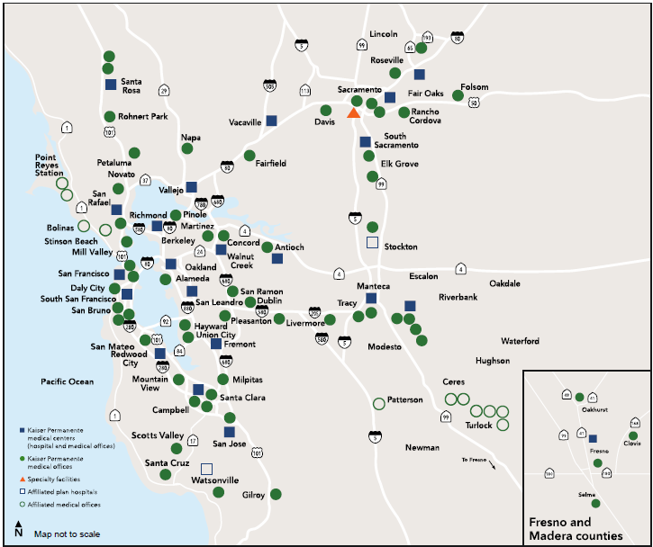

Kaiser Permanente Coverage Map
Health Plan availability based on residential zip code. Employee must live or work in service area within California
Notes:
Kaiser does have a live/work rule, which means you have to either live in the service area or work within the service area. Lake County and Mendocino Counties are not in the residential service area. One note of caution – many county positions allow for teleworking. If you are teleworking full time and do not come into any county facility, then live/work rule does not apply.
If you’re not sure if you’re in the residential service area, we can look up zip codes for you

Slide 21
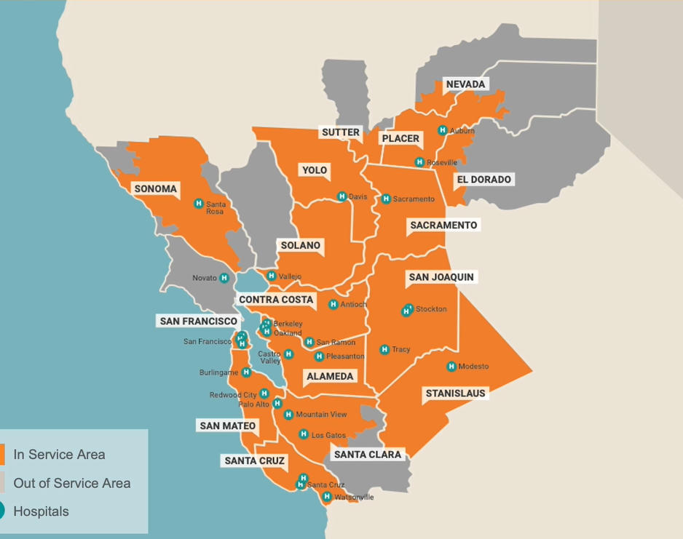

Sutter Health Plan Coverage Map
Health plan availability based on residential zip code. Employee must live or work in the Sutter Health Plan service area within Northern California.
Notes:
Sutter also has a live/work rule, which is good thing for most county employees because as you can see there are residential areas in Sonoma and Marin and Napa counties that are not part of the service area. If you can’t use the live/work rule because you don’t work onsite at a Sonoma County facility, at any point in your regular work schedule, then we’ll be happy to look up your zip code and determine whether you live in the service area.

Slide 22
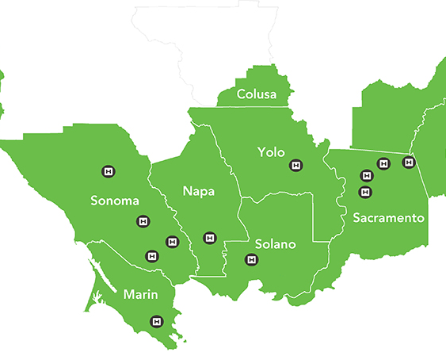






Western Health Advantage Coverage Map
Health plan availability based on residential zip code. All participants must live or work in the service area within Northern California.
Affiliated Medical Group Providers:
Notes:
For WHA you also have the live/work rule. Some gray areas within Sonoma county, including around Guerneville and Jenner. Definitely ask us about your zip code if you’re in a more remote part of the county or a neighboring county and DO NOT work at a county facility at any point in your regular work schedule.
IMPORTANT TO KNOW: LIVE/WORK RULE ONLY APPLIES TO EMPLOYEES, NOT DEPENDENTS. YOU CANNOT COVER DEPENDENTS OUTSIDE OF THE SERVICE AREA.

Slide 23

Delta Dental PPO
One premium for Self or Family Coverage
Two networks - PPO and Premier
No deductible
80% of “reasonable and customary” charges
100% of preventative and diagnostic services
$3,000 calendar year annual maximum per person
50% orthodontic benefit with $6,000 lifetime maximum
Covers adults and children
Dependents covered up to age 26
Benefits are the same in and out of network
2025-2026 Semi-Monthly Premiums
Bargaining Unit | Employee Contribution | County Contribution | Total Premium
ESC, SCLEA, SCLEMA, SCPDIA, LOCAL 39 | $13.04 | 46.24 | 59.28
WCE | $25.00 | 34.28 | 59.28
All Others | $14.13 | 45.15 | 59.28
Notes:
There is an employee contribution, but the amount doesn’t change based on how many people are on the plan.
Two networks, PPO and Premier – you’re automatically enrolled in both.
There’s no deductible. The plan covers 80% of reasonable and customary charges but for preventative and diagnostic services, like regular cleanings, it’s actually 100% starting June 1.
3,000 calendar year maximum on what plan will pay. Pretty unusual for group dental plans!
We also have orthodontic benefits – it’s a lifetime maximum. Everything else is annual. Dependents covered up until age 26, just like others

Slide 24
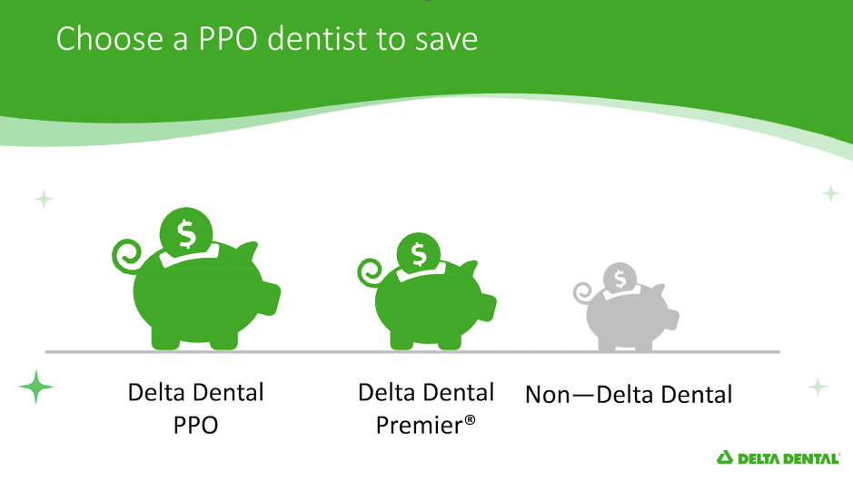
Choosing a Dentist
PPO and Premier Dentists
Contracted rates with Delta
Lower cost for PPO = less out of pocket for you
Dentist’s rates above the agreed upon contracted amount cannot be balance billed
Out of Network Dentists
Benefits are the same as in network dentists
Delta pays based on “Reasonable and Customary’ rates
You will be responsible for the balance billed between what the dentist's charges and what Delta pays
Notes:
We do have a video – explains differences between the two. The sound does cut out some times – that’s just part of the video.

Slide 25
Vision Service Plan
Vision Plan (All Members)
County paid family coverage
Dependents covered up to age 26
No co-pays for most services
Eye Exams covered in full every 12 months
Frame allowance $150 every 24 months
Contacts (instead of glasses) $130 allowance every 12 months
VSP’s KidsCare Plan (Children up to age 26)
Less than 12 months if new prescription differs at least .50 diopter sphere or cylinder, change in the axis of 15 degrees or more, or .5 prism diopter change in at least one eye.
Frames and contacts every 12 months
Computer VisionCare (Employees Only)
Frames – Up to $125 frame allowance every 24 months
Lenses – Single Vision, lined bi/trifocal and occupational lenses
Discounts on additional frames and services
Notes:
Traditional HMO – you know what costs will be, this is the most predictable category in terms of costs. Fixed co-payments and no deductible.
Hospital Services – mostly predictable, it’s a middle of the road alternative to either the HMO or the high deductible plan. There’s no deductible if you see a doctor but you will have a deductible for hospital services, outpatient or inpatient surgeries, and emergency room visits. but there’s also no deductible for prescriptions. So you’ll pay a lower premium but have some greater risk for out of pocket costs if you do need hospital services.
High DED – deductible applies to all services, you pay full cost out of pocket for everything until you hit your deductible, then the plan takes over, along with some co-pays and coinsurance for you.
There are three HMO options and we’ll go through each now. Kaiser, Sutter, and Western Health Advantage.

Slide 26

Flexible Spending Account (FSA)
A pre-tax employee funded reimbursement account
January 1 thru December 31 Plan Year
You may enroll within 31 days of hire
Annual Enrollment in the Fall for the following plan year
Participants must enroll annually to participate.
May elect a change in annual election with eligible mid-year events, within 31 days of event.
Plan Features:
Debit Card
Cards can be used at POS for eligible expenses.
Save your itemized receipt in case documentation is requested
If you are unable to use your FSA debit card, claims by be submitted via the portal.
Online Account Access and Mobile App
Notes:
The flexible spending account is an employer-sponsored program that allows you to set aside pre-tax money for reimbursement for eligible expenses incurred by you or your eligible dependents. It’s 100% funded by you, but this can lower your taxable income, increase your overall take home pay, and there are no fees to participate. It’s a great way to set aside pre-tax dollars from your paycheck every month, that you can use for health expenses, or dependent care, which I’ll discuss in a moment.
Unlike the rest of our plans, the FSA plan year is based on the calendar year, January 1 through December 31. You all have 31 days from your hire date to submit the form, and you would be starting with the 2024 plan year. If you don’t elect now, then the next opportunity would either be at annual enrollment next Fall or if you have a qualifying life event. Just like with the other plans, if you do have a qualifying event, you have 31 days from the event date to submit an enrollment form. And for FSA, not all qualifying life events that apply to other benefits apply to FSA.
It’s important to note that annual enrollment for the FSAs is an active or “opt-in” program – you must complete the form every year – if you do nothing at annual enrollment, JUST FOR FSA, then you will not be enrolled the next year.
The plans are administered by the P&A Group. P&A does provide you with a debit card. If you have expenses that you cannot use the debit card for, you would submit receipts to P&A through their app or the online portal or via mail or fax. If submitted online, the reimbursement is pretty quick. Their system is pretty user-friendly - you can even take a picture of the receipt and upload it.
December new hires ineligible for current year.

Slide 27
Flexible Spending Account Plans
Dependent Care Assistance Plan (DCAP)
$7,500 Annual Maximum
Caregivers for disabled or elder care (dependent on tax return)
2.5-month grace period for additional claims
Deadline to submit expenses (including grace period expenses) is March 31 following the plan year
Health FSA
$3,400 Annual Maximum
Covers out-of-pocket medical, dental, and vision care expenses
Insurance deductibles and co-payments
Over-the-counter medications
$680 rollover into the next plan year
Eligible day care, after school care, babysitters for children under the age 13
Notes:
There are two different Flexible Spending Accounts, with different rules and regulations. The first is Dependent Care Assistance Plan. The annual maximum that you can allocate from your pre-tax dollars is $5,000. This is for eligible day care, after school care, babysitters for children under 13, or caregivers for disabled or elder care. The dependent must be on your tax return for disabled or elder care caregivers.
Also both you and your spouse, if applicable, must be employed or seeking employment to be eligible for this benefit
There is grace period to submit additional claims but it’s also very important to get your claims in in a timely fashion. The dependent care plan is use it or lose it. This is your money pulled from your paycheck, and there’s no roll over for DCAP like there is for the health FSA. So make sure you don’t set aside too much! The smallest amount you can set aside is $130 for the whole year. Dependent care FSA is use it or lose it. No roll over at year end, but you do have a grace period until March 15 of the following year to incur expenses. You have until March 31 to submit documentation of your expenses.
The health FSA has an annual maximum for the coming year of $3,300. Can cover out of pocket medical, dental, and vision care expenses. This could include insurance deductibles, co-payments, and over the counter medications. This can also include a wide variety of items such as Tylenol, band aids, allergy medications, antibiotic ointments, crutches, orthopedic shoes, etc. etc. It’s a very long list and covers a wide variety of types of expenses. We have a link on our website and the P&A Group has a list on their website. The P&A Group also has an online store where you can buy eligible items directly from them.
If you allocate $3,300 or another high amount, but do not use the full amount in 2025, you can roll over up to $660 into the next calendar year. Any remaining balance greater than $640 however will be lost and unusable moving forward. Any questions??

Slide 28

How much should you elect to put in your FSA?
You can enroll in the Health FSA, Dependent Care Assistance Plan, or Both
Money set aside in the specific FSA must be used for the designated spending account.
Funds cannot be mixed or transferred
Review the list of eligible expenses for each of the plans
Be conservative when estimating your healthcare expenses
Make sure you contribute funds you are confident you will spend in the plan year.
You will forfeit unused funds at the expiration of the grace/carry forward period.
Notes:
So how much should you elect for FSA or dependent care, and how should you decide? If you can, try to calculate how much you will need before you make your elections. We recommend that you be conservative in the first year especially, and after the first year you will then have a better idea of how quickly you can get through your allotted amounts. You really don’t want to lose the funds, although there are many eligible expenses if you are running short at the end of the year. There is a large comprehensive list of eligible expenses on the P&A site.
In general, if you know you will have a lot of out pocket expenses, like for instance if you know you have a surgery coming up next year, or a new prescription that could be expensive, it probably makes sense to set aside the full amount.
And it’s really important to remember that the health FSA and dependent care FSA are completely separate. You can’t transfer funds between the two, you can’t use remaining funds from one for expenses from the other. They are truly independent and unconnected.
And just another reminder of why FSA is valuable for you. The money that is put into these accounts is your money, from your income, but it’s taken out pre-tax, so it reduces your taxable income and thus your overall tax liability. Does that make sense to everyone?

Slide 29
Retiree Medical Benefits
Health Reimbursement Arrangement (HRA)
for Employees hired on or after January 1, 2009:
2 year waiting period or equivalent # of hours
Regular full-time and part-time employees (.50 FTE)
Contributing member of SCERA
Initial County Contribution $2,400 after waiting period (FT)
After Initial Contribution: $0.58/hour (approx. $100/mo.)
Account is available upon retirement for retiree medical expenses.
Notes:
No matter where you are at in your life, the county will begin contributing funds toward a Health Reimbursement Arrangement that is considered a retiree medical benefit. This has been true for all county employees hired since 2009. When you do retire, you will be eligible to enroll in county-sponsored plans, but you would pay the full cost of the premium. The HRA balance is the monetary aspect of the retiree medical benefit for those of us hired 2009 or later.
The benefit doesn’t kick in until you have worked for two years, or an equivalent number of hours if you are part time. It’s for regular FT and PT employees with at least .5 FTE and you MUST a contributing member of SCERA, scera, the county employee retiree association.
The initial contribution after two years or an equivalent number of hours is $2,400 and after that the county contributes approximately 58 cents per hour, although that does vary by bargaining unit. The balance in the account builds but you do not have access to use the funds until you have separated from the county and are age 50. Both conditions have to be met. And even though it’s referred to as a retiree medical benefit, you do not have to actually retire directly from the county to use the funds. If you are already 50 when you separate from the county, you will need to contact the Benefits Unit and let us know and we will make the funds available to you then.
If you separate from the county before age 50, you must come back to use at age 50 and let us know that you have reached the qualifying age, and we will transfer the funds so you can use them.
It’s a health reimbursement arrangement. It’s not a use it or lose it situation, although once the funds are available to you there is a small admin fee, and it does not affect what plans you can enroll in like a Health Savings Account does. In case there is any confusion, we do not offer a Health Savings Account.
And there’s no maximum to how much the county can put in there. If you are just starting your career with the county and could be here for 20, 25, 30 years, and then the pool of money waiting for you when you retire will be quite significant.
PT is pro-rated also based on how many hours worked
Medical, dental, and vision.
Visit P&A Group at www.padmin.com for more information

Slide 30

Life Insurance
County Paid
Basic Life & AD&D
30+ hours/week (.75 FTE)
Amount varies by bargaining unit
Part Time DSA, SCLEA & ESC may purchase at your own expense.
Employee Paid
Supplemental Life
May elect up to 3x your basic life not to exceed $500,000 (basic and supplemental combined)
Cost based on employee age
Keep beneficiaries up-to-date
Automatically approved without providing evidence of good health when enrolling as a new hire or newly eligible employee.
Supplemental Dependent Life
$5,000 coverage for each qualified dependent
$0.23/pay period
Employee is beneficiary
Notes:
The county pays for basic life insurance as long as you are a .75 or higher FTE, so roughly 30 hours a week. The amount of the benefit varies by bargaining unit, so you will need to consult your MOU or our website. If you are below .75 but in one of those three bargaining units, DSA, SCLEA or ESC, you may purchase life insurance at your own expense.
The maximum amount of life insurance, Basic and Supplemental combined cannot exceed $500,000.
To be eligible to purchase Supplemental Life the employee MUST HAVE basic life insurance coverage. And the cost is based on your age. The amount you pay depends on the age you will reach during that coming year. If you turn 50 next year, your premium changes on January 1. We have tables on our website and in our employee benefits guide that show the breakdown of costs.
What is it? It’s important to know that the life insurance benefit only pays out to your beneficiary if you pass away, and unless you choose to port or convert the benefit when you retire or separate from the county, then the benefit ends on your last day of employment. Portability and conversion are methods to keep the insurance going but you pay the full cost of the premium.
Benefits are disbursed to your beneficiaries in lump sum to assist in paying for things like burial, funeral expenses, debts such as loans or mortgages, and can also used for future expenses like college tuition, childcare
Keep your beneficiary up to date – if you go through a divorce or any other major event, you may want to consider changing it. If you are in California and you are married, and you want to designate someone besides your spouse as one of your primary beneficiaries, you will have to complete a separate form and the spouse has to sign off on the designation, and the form must be notarized.
Always be sure to have a beneficiary form on file - If you don’t turn a form in at all, and you were to pass away, the claim goes to the state and your family has to go through a long process to get the benefit.
Any life change – consider whether you want to change your benny.
You can increase your supplemental life amount at annual enrollment, but if it’s more than one increment, you will have to complete Evidence of Insurability. Right now, as a new hire, you are automatically approved for any amount of supplemental life insurance up to three times your basic life amount without needing to provide evidence of good health.(remember $500,000 combined max). This is considered the Guarantee Issue period, and it’s important to consider if you want to start supplemental life now, you do have the opportunity to choose any amount. If you are interested in supp life, now is the time to do it. Otherwise you will need underwriting approval, based on health questionnaire.
There is one other time when you could change the amount of your benefit, but it comes with a caveat – you can change your amount when you change bargaining units, but only if the BUs have different policies. We will reach out to you when you change bargaining units and lay out your options for you.
Dependent life – 0.23 per pay period, not per dependent. We don’t even ask any more for a list of your covered dependents. They must just be eligible dependents according to the criteria we spelled out earlier for medical and dental benefits. And If you have dependent life when your only dependent turns 26, let us know because you will not want to keep paying, of course.

Slide 31
Staff Development & Wellness Allowance Program
Professional Development Expenses (may be non-taxable if job related)
Wellness and Physical Fitness Expenses
Computer, Hardware and Mobile Device Expenses
Emergency Preparedness
Ergonomic Office Expenses
Effective July 1, 2023, DSA, DSLEM and SCLEMA not eligible for reimbursement program, but receive yearly stipend for staff development instead.
Effective July 1, 2025, SEIU not eligible for Staff Development and Wellness program
Contact staffdev@sonomacounty.gov directly with more questions
Notes:
So I wanted to briefly touch on a benefit that was just negotiated in the most recent round of MOUs. Members of those four bargaining units are eligible for an annual Sonoma County parks membership. The parks pass gives you access to parking at more than 55 parks, one free night of camping, boat launches at Doran beach, Westside park and spring lake, as well as other discounts.
It’s important to know that the membership is good for one year and can be activated any time between now and June 30 of next year, so if you already have a pass, you can wait until it expires to redeem this one. When you’re ready, you just need to email Employee Relations with your employee ID and name of your bargaining unit. They will respond with a membership activation code – just know that because this is a new benefit for over 2000 employees, the turnaround time could be up to a couple weeks right now. You do need to show that activation code to the Parks department, either in person or online, to receive the pass.
Remember it’s only for these four BUs

Slide 32

Regional Parks Annual Membership Benefit
For SEIU (incl. Extra Help), ESC, SCPA, SCDPDAA
Annual Membership, obtain code
Parking pass good at more than 55 parks
One night of camping at a Regional Park campground
Other discounts and perks
Complete online form on Benefits website (under Employee Benefits) to receive code. Take code in person to Parks Department or order pass online via code
Notes:
So I wanted to briefly touch on a benefit that was just negotiated in the most recent round of MOUs. Members of those four bargaining units are eligible for an annual Sonoma County parks membership. The parks pass gives you access to parking at more than 55 parks, one free night of camping, boat launches at Doran beach, Westside park and spring lake, as well as other discounts.
It’s important to know that the membership is good for one year and can be activated any time between now and June 30 of next year, so if you already have a pass, you can wait until it expires to redeem this one. When you’re ready, you just need to email Employee Relations with your employee ID and name of your bargaining unit. They will respond with a membership activation code – just know that because this is a new benefit for over 2000 employees, the turnaround time could be up to a couple weeks right now. You do need to show that activation code to the Parks department, either in person or online, to receive the pass.
Remember it’s only for these four BUs

Slide 33

Clean Commute
Employees ride City of Santa Rosa and Sonoma County Transit buses for free (just show employee badge)
Incentive Program – Lump sum incentive payment of $240 if you carpool, bike, walk, or take the bus to work at least 48 days within a 6-month period, either Jan-June or July-Dec (use online Trip Tracker)
Free EV charging and bike parking
Emergency Ride Home (County reimburses cost of taxi or ride share for emergency needs if traveling to work via alternative means)
More information on Benefits website, under Clean Commute
Contact triptracker@sonomacounty.gov directly with more questions

Slide 34

Employee Assistance Program (EAP)
Confidential and Professional Counseling at no cost to you
6 sessions per episode
All employees and members of their household
Online services, including Zoom
Access service by calling 866-248-4096 or by visiting www.liveandworkwell.com
Counseling
Chemical Dependency
Child and Elder Care
Federal Tax Problems
Financial and Credit Concerns
Legal Questions
Pre-retirement Planning

Slide 35

CareCounsel Health Advocacy Program
Employer paid and confidential
Access service by calling 888-227-3334 or by visiting www.carecounsel.com
Choosing a
Health Plan
Selecting and locating doctors and hospitals
Troubleshooting claims issues and appeals
Getting the most from your health care dollars
Finding resources for a health condition
Benefit Questions

Slide 36
Short and Long Term Disability
Available to permanent County Employees regularly scheduled 32 hours/pay period (.40 FTE)
Short Term Disability
Employees covered under the following Bargaining Units may participate in a Short-Term Disability benefit offered through Dublin Insurance and fully paid by the employee.
ü SEIU ü ESC ü SCPA
To enroll, contact Dublin at 800-824-3316
Long Term Disability
Two separate insured Plans:
Plan A – Standard LTD Plan, Employer paid plan through the Standard Insurance Co. with a 60-day waiting period from date of disability
Plan B – Employee paid LTD Benefit through Trust of Peace Officers Research Association of California (PORAC), mandatory participation for the following BUs:
ü SCLEA ü DSLEM ü SCLEMA ü DSA
ü Salary Resolution – Confidential Only

Slide 37

New Hire Enrollment
You must submit your elections for benefits within 31 days of hire!
Your coverage begins on the 1st of the month following your hire date
Medical, dental, and vision coverage may take up to 2-3 weeks from receipt of your enrollment forms to be active with the providers
Documentation is needed for eligible dependents included in coverage
If we do not receive forms from you within 31 days of your hire date, you will have to wait until the Annual Enrollment to enroll with a June 1st effective date!
Notes:
You have 31 days from your hire date to complete and submit your enrollment form to the Benefits Unit, otherwise you will have to wait until Annual Enrollment or experience a qualifying mid-year event. Annual enrollment takes place in the Spring and changes take effect June 1.
When does your coverage start? If you are enrolling as a new hire, coverage begins on the first of the month after your hire date. This is true even if you turn the form in after the first of that month. In this case, if your hire date is today but you don’t turn the form in until February 2, then we will still make the coverage effective February 1. However you may have a double deduction on your second paycheck in February, depending on the plan you choose and the timing of when you turn the form in. So remember, you do have the full 31 days to make your election, but if you are worried about having a gap in coverage, it’s best to turn the form in as soon as possible so we can complete our processing in a timely fashion.

Slide 38
How do I enroll in benefits?
Before you get started, you will need the following information:
- Names
- Birthdates
- Social Security Numbers
- Dependent Verification Documentation
Complete Enrollment Form
Benefit Enrollment eForm – REQUIRED
https://sonomacounty.gov/benefits/benefits-enrollment-eform
Important
You have 31 days from your date of hire to submit your benefit enrollment forms. Incomplete forms may cause a delay in processing and timely enrollment.
Contact the HR Benefits Unit
hr.benefits@sonomacounty.gov
For questions regarding your benefit options or a link to the eform
Notes:
So the medical, dental and vision are the three main health coverages that we offer. When you are completing your forms, be sure you have all of this information prepared and handy. Names, birthdates, social security numbers, and that dependent verification documentation that we discussed earlier.
As long as your FTE is at least .75, which is 60 hours per pay period, then you will need to turn in both our enrollment form and the life insurance beneficiary form. We need both forms whether you wish to enroll in the elective options or not. Because you are automatically enrolled in life insurance, we are required to have that beneficiary form on file.
Based on the timing of your start date, and when you submit the forms, it’s quite possible the insurance carrier might not have the enrollment at the start of the month, but the coverage will still be retroactive to the first of the month after your hire date. We only submit files to the insurance carriers every two weeks.
And don’t forget, this is very important, you have 31 days from your hire date to submit your enrollment forms.
We recommend making and holding on to a copy of your form, with your signature and date, for yourself, and if you submit the forms via interoffice mail or another method besides email, please reach out to us just to confirm that we received the paperwork and supporting documentation.
If you enroll in supplemental life insurance or the flexible spending account, there are separate forms. We’ll talk about those in more detail in a bit!

Slide 39
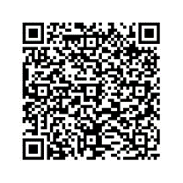
Scan the QR code for the Benefits webpage!
HR Benefits Unit
707-565-2900
Email: hr.benefits@sonomacounty.gov
Website: sonomacounty.gov/benefits
Staff Development Customer Service
707-565-3900
Email: staffdev@sonomacounty.gov
Website: sonomacounty.gov/staff-development
Notes:
Websites are correct

